Slide 1
AI in Project Management
Mandeep Singh
(FIT5057: Project Management)

Slide 2
Motivation
$48 trillion investment in projects ^{[1]}
Successful project completion: only 35%
Reason:
Continuously changing businesses
Low level of Project Management tech stack for adaptive approach in terms of:
- automation
- ‘intelligent’ features
AI-enabled tech limited to only risk management
[1] Harvard Business Review, (2023, February) “How AI Will Transform Project Management”, (link)

Slide 3
Introduction
Gartner’s research: by 2030, 80% Project Management tasks run by AI ^{[1]}
Major dimensions of AI transformation:
Better selection & identification of projects
Support for Project Management office (real-time data analytics & automation)
Improved, faster project definition, planning & reporting
Virtual Project Assistant
Advanced testing system
A new role for Project Manager
[1] Harvard Business Review, (2023, February) “How AI Will Transform Project Management”, (link)

Slide 4
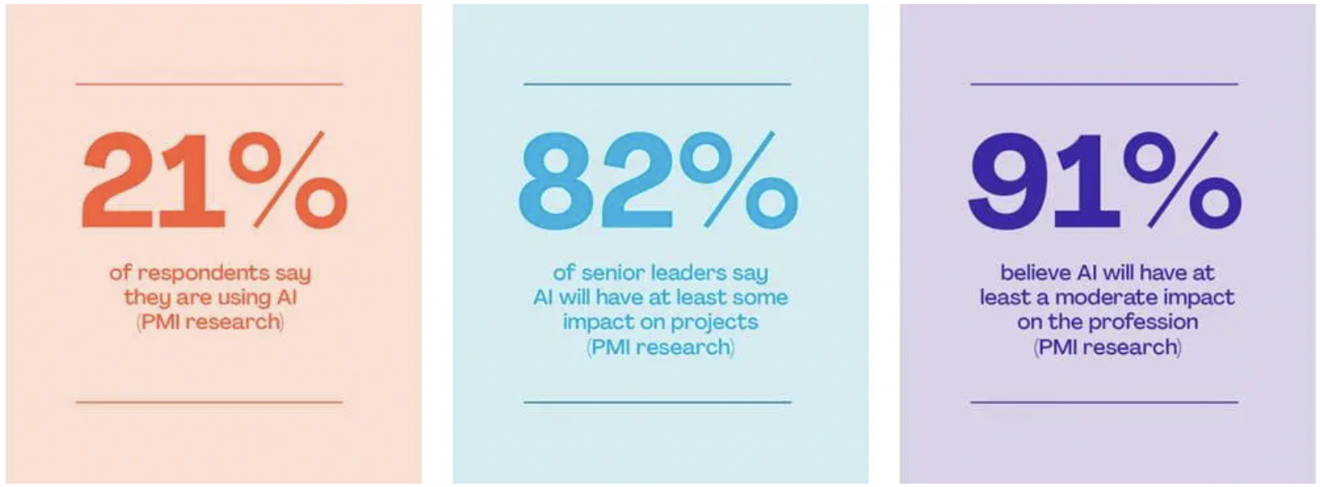
Impact (PMI)
AI impact on Project Management
[2]: Project Managament Institute, (2023, October.), ’ Shaping the Future of Project Management With AI’, (link)

Slide 5
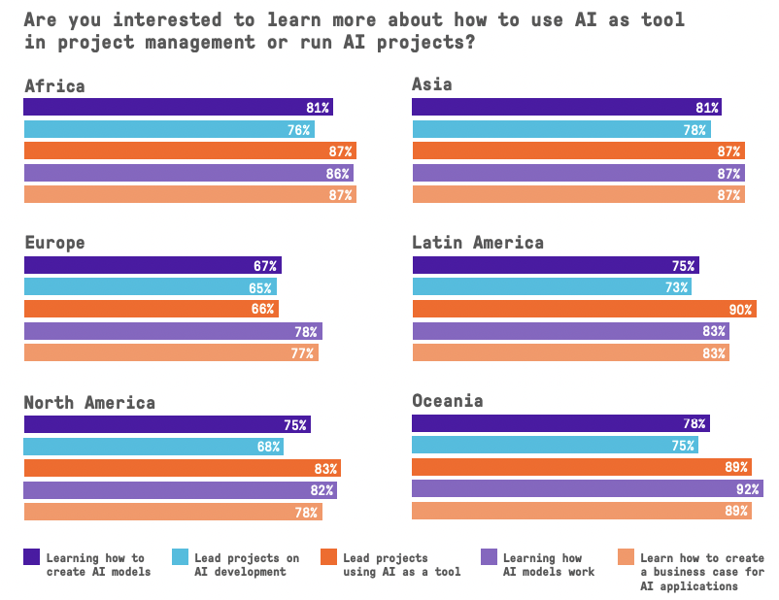
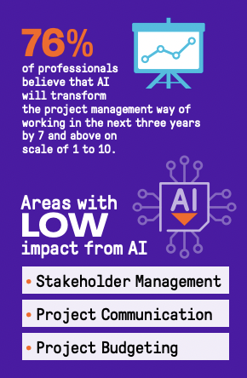
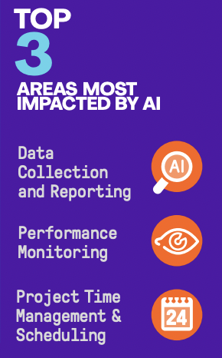
Impact (PMI)
AI impact on Project Management
[3]: Project Managament Institute, (2023, October.), ’ Artificial Intelligence and Project Management’, (link)

Slide 6
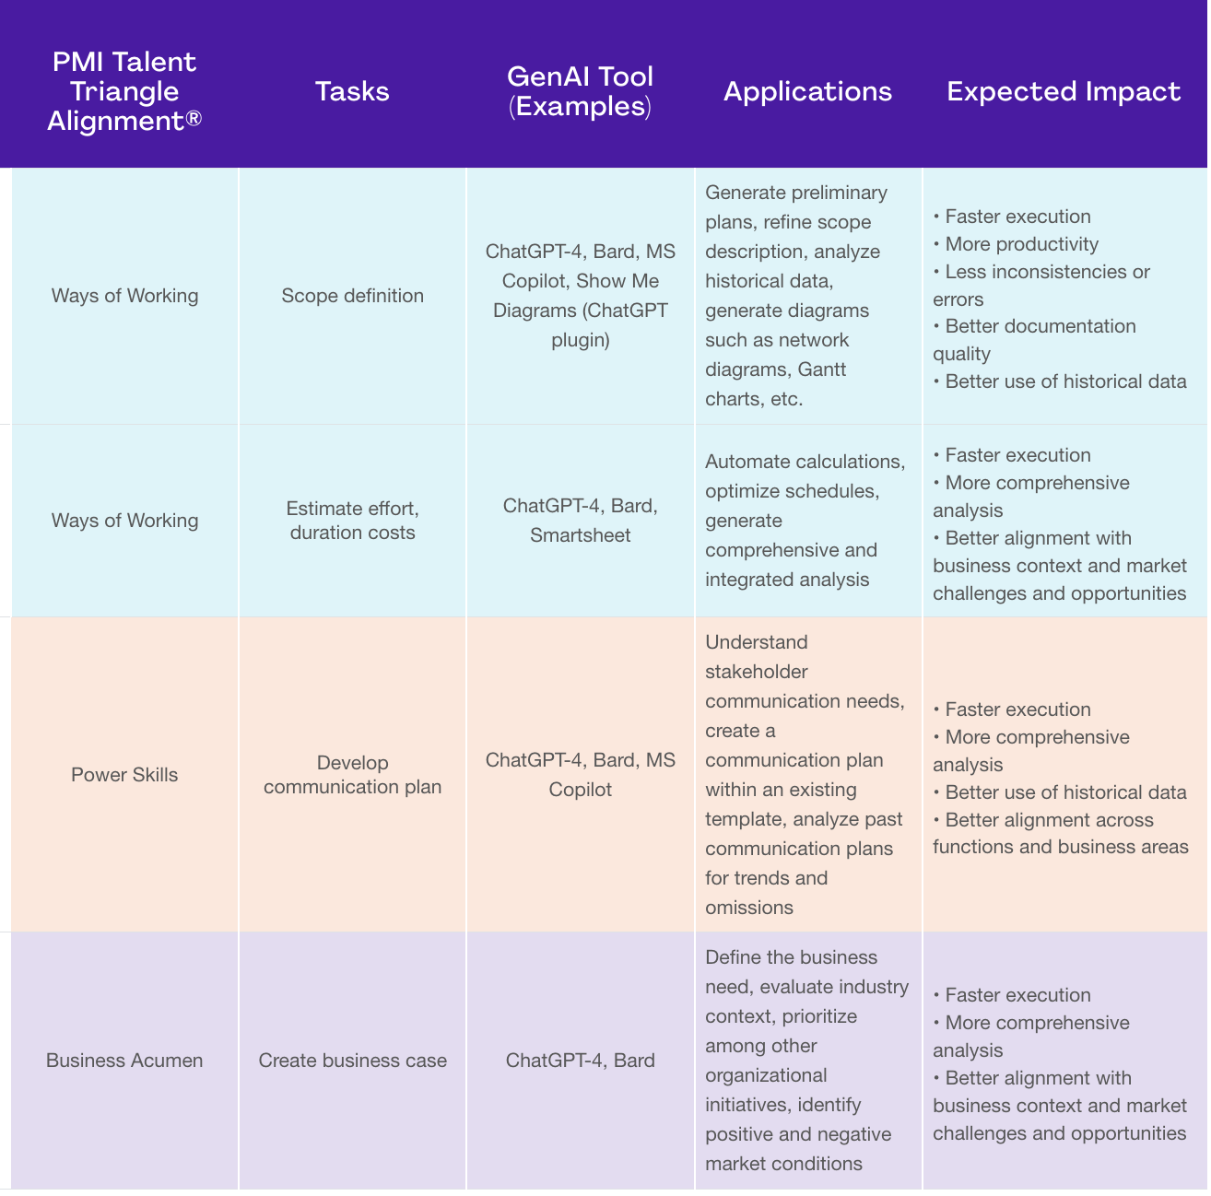
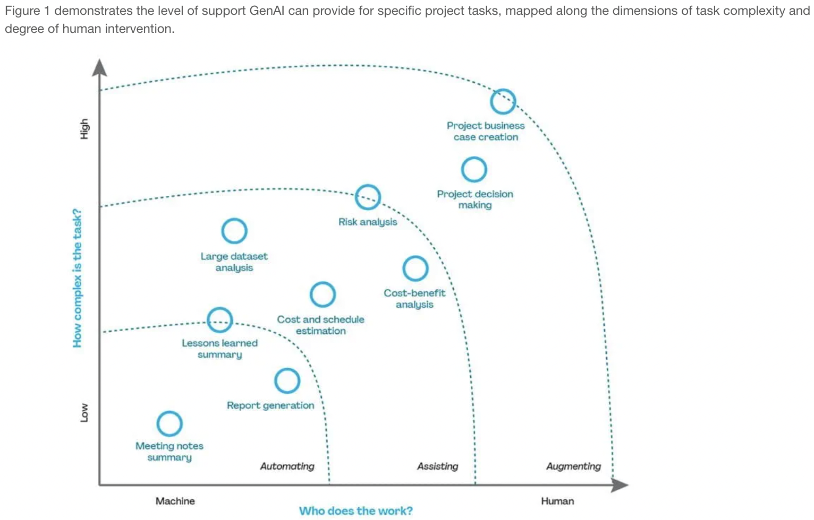
PMI (GenAI)
Project Performance Domain: Planning
[2]: Project Managament Institute, (2023, October.), ’ Shaping the Future of Project Management With AI’, (link)

Slide 7
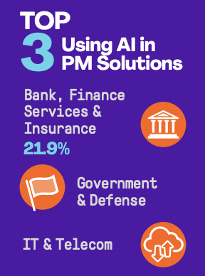
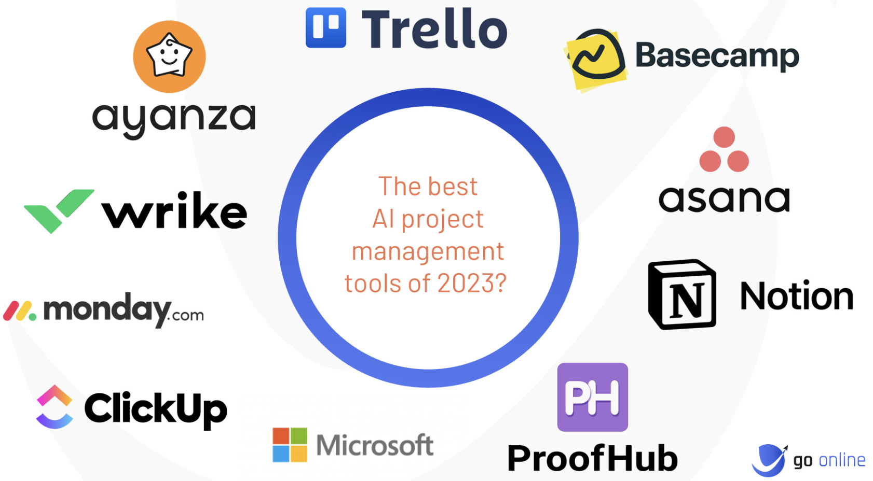
Market Space
Oracle AI Smart: (Enterprise Resource & Performance Management) ^{[4]}
- Digital Assistants: Expense reporting, project management
- Advanced financial & access control
- Intelligent Supplier Management
[3]: Project Managament Institute, (2023, October.), ’ Artificial Intelligence and Project Management’, (link)
[4]: Oracle Adds AI Smarts to Increase Oracle ERP Cloud’s Market Lead (link)
[5] Barker L., (2023), “AI Project Management Softwares”, (link)

Slide 8
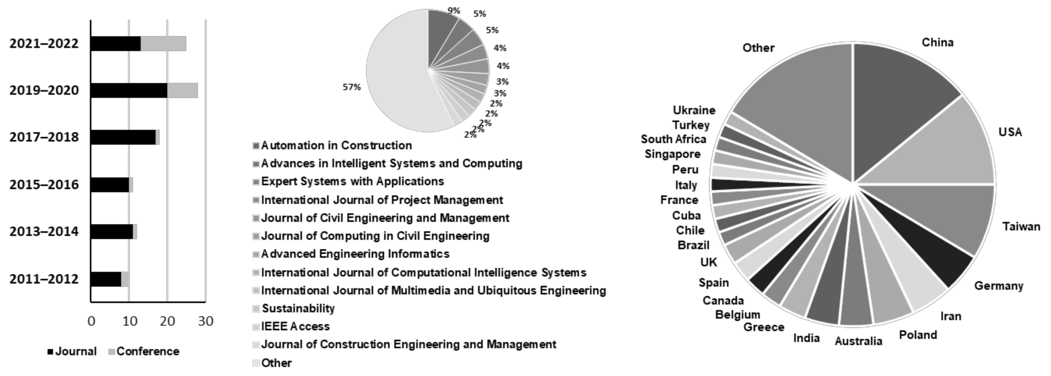
Research trend
Distribution of the AI-assisted Project Management research ^{[6]}:
[6] Taboada et.al.m (2023, April), ‘Artificial Intelligence Enabled Project Management: A Systematic Literature Review’ (link)
Notes:
WoS & scopus literature searches: 128 papers related to AI-enabled PM

Slide 9
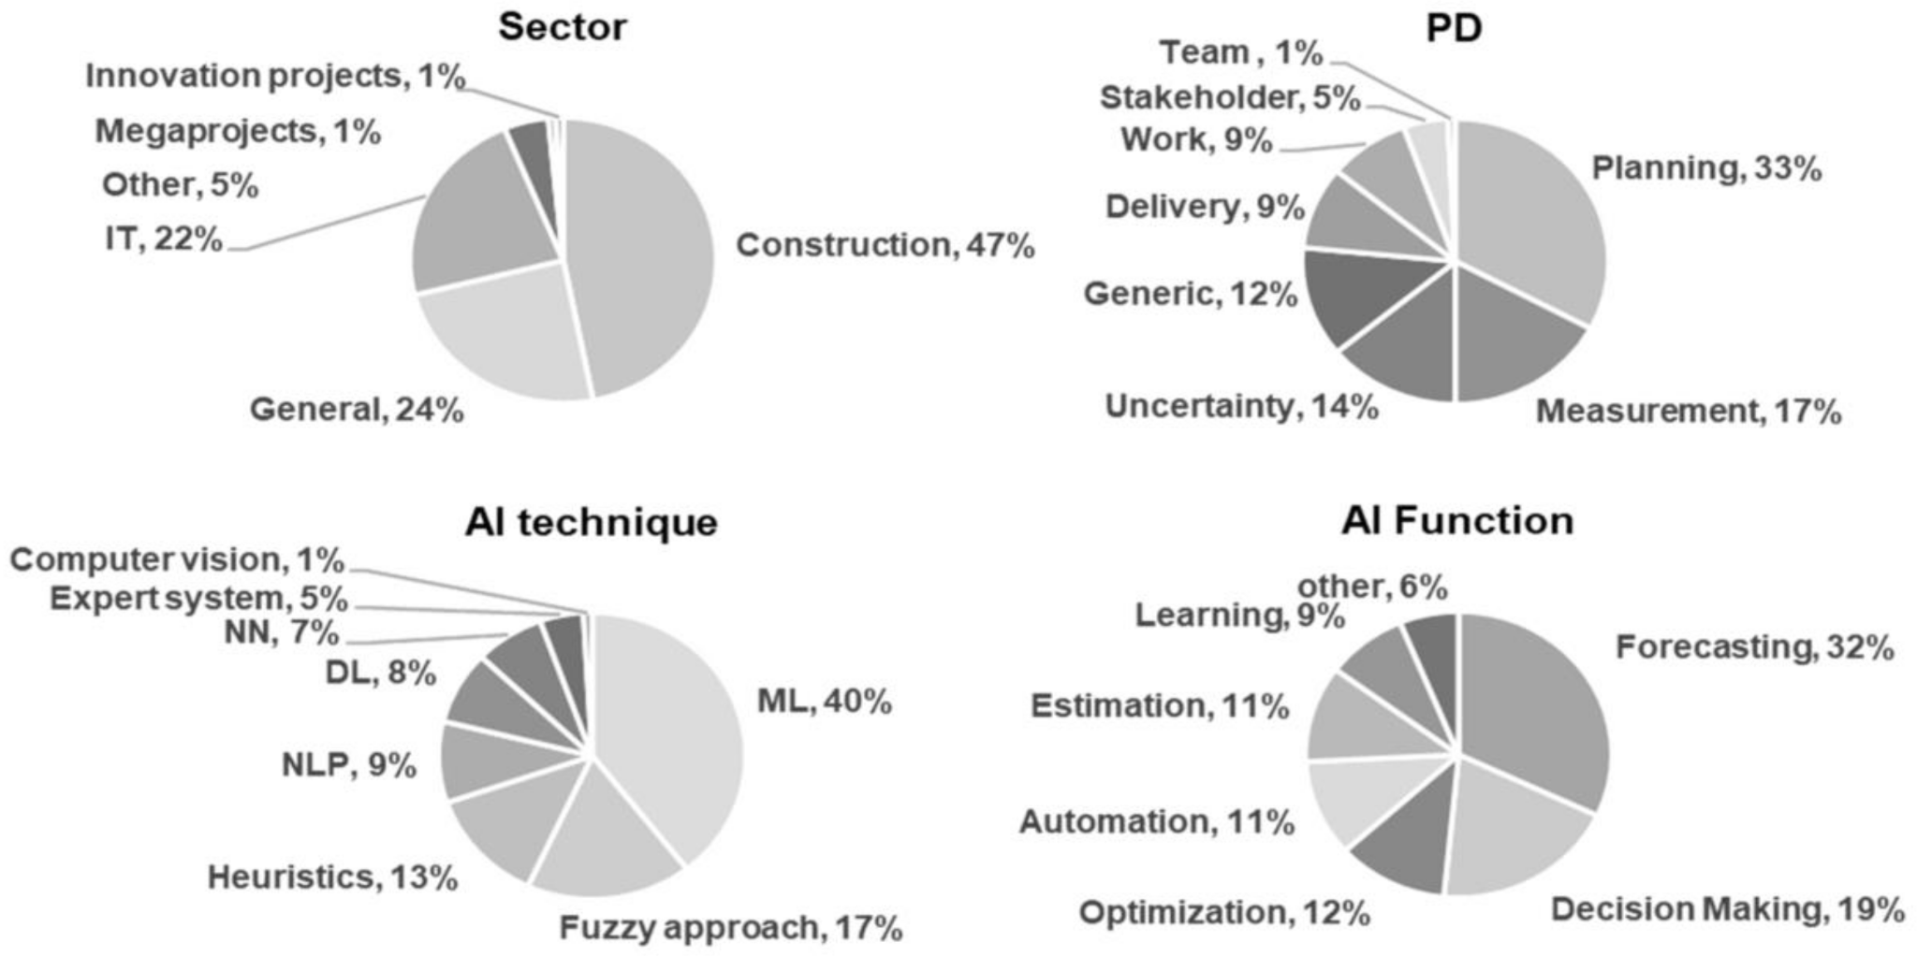
Research trend
Distribution of the AI-assisted Project Management research ^{[6]}:
[6] Taboada et.al.m (2023, April), ‘Artificial Intelligence Enabled Project Management: A Systematic Literature Review’ (link)
Notes:
Literature review: Delay level predictions, Earned Value Management (fuzzy, NN), precise cost forecasts (eg. transmissions/highways),
Monitoring worksite data, RISK prediction: ML (decision tree, bayesian ML, ANNs, fuzzy-analytics)

Slide 10
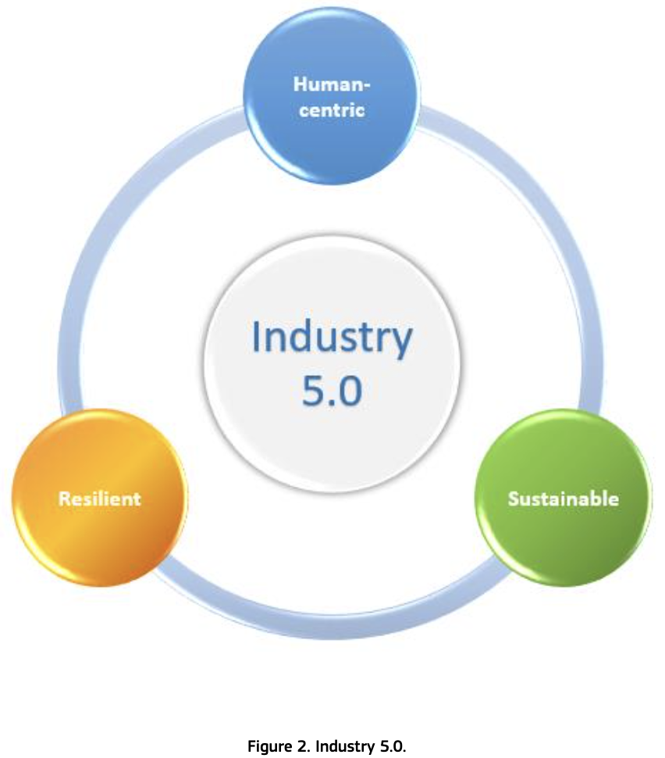
Industry 5.0
- Currently, adoption of digitization in European industrial landscape is more gradual than disruptive and uptake of technology is more linear than exponential.
- Industry 5.0 ^{[6]} promises of advanced digitalisation, big data & Artificial Intelligence.
Using rapid enhancement & improvisations in technology:
- Human-centric: Production process adaptation based on workers needs
- Resilient: Robust industrial production to provide & support critical infrastructure
- Sustainable: Adoption of the 3R principle (Reduce, Reuse, Recycle) as per UN SDG
[7] European Commission, Directorate-General for Research and Innovation, Breque, M., De Nul, L., Petridis, A. (2021). Industry 5.0 : towards a sustainable, human-centric and resilient European industry, Publications Office of the European Union. (link)
Notes:
Industry 4.0: Germany (2012)

Slide 11
Industry 5.0
- Resource efficiency for energy intensive industries
- Resilient technologies: automated risk monitoring, management & mitigation measures
Eg. Deep Reinforcement learning for adaptability boost
- Connected smart factories 4.0 model:
- Zero break-down sustainable operations.
- Agile customer-driven manufacturing value network
- Advanced circular & agile industrial ecosystem: use of AI for product life-cycle management & assessment.
- Automated supply chain management.
[7] European Commission, Directorate-General for Research and Innovation, Breque, M., De Nul, L., Petridis, A. (2021). Industry 5.0 : towards a sustainable, human-centric and resilient European industry, Publications Office of the European Union. (link)

Slide 12
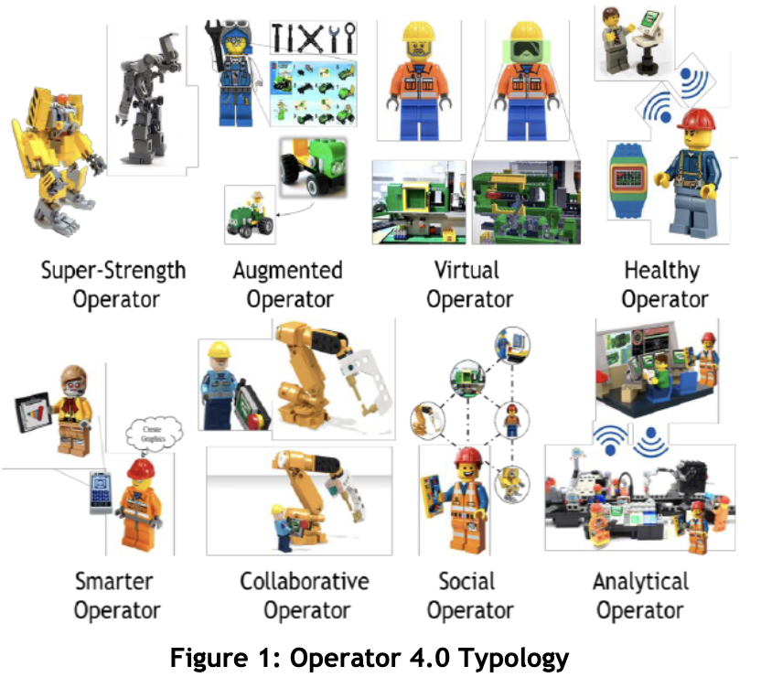
Industry 5.0
Topology for Operator 4,0 ^{[8]}:
- Human cyber-physical production system (H-CPPS)
- Intelligent Personal Assistant: Smarter Operator
- Analytical operator: use of big data analytics to achieve better forecasts, with near real-time performance measures providing greater visibility for KPIs & quality measures.
Highly effective for the project managers to leverage the AI enabled technologies in industry.
[8] Romero, D., Stahre, J., Wuest, T., Noran, O., Bernus, P., Fast-Berglund, Å., Gorecky, D.: Towards an operator 4.0 typology: a human-centric perspective on the fourth industrial revolution technologies. In: Proceedings of the International Conference on Computers and Industrial Engineering, pp. 1–11 (2016). (link)
Notes:
2017: 3.3M non-fatal accidents reported > 8 future projection of extended workers

Slide 13
References
[1] Harvard Business Review, (2023, February) “How AI Will Transform Project Management”, (link)
[2] Project Managament Institute, (2023, October.), ’ Shaping the Future of Project Management With AI’, (link)
[3] Project Managament Institute, (2023, October.), ’ Artificial Intelligence and Project Management’, (link)
[4] Oracle Adds AI Smarts to Increase Oracle ERP Cloud’s Market Lead (link)
[5] Barker L., (2023), “AI Project Management Softwares”, (link)
[6] Taboada et.al.m (2023, April), ‘Artificial Intelligence Enabled Project Management: A Systematic Literature Review’ (link)
[7] European Commission, Directorate-General for Research and Innovation, Breque, M., De Nul, L., Petridis, A. (2021). Industry 5.0 : towards a sustainable, human-centric and resilient European industry, Publications Office of the European Union. (link)
[8] Romero, D., Stahre, J., Wuest, T., Noran, O., Bernus, P., Fast-Berglund, Å., Gorecky, D.: Towards an operator 4.0 typology: a human-centric perspective on the fourth industrial revolution technologies. In: Proceedings of the International Conference on Computers and Industrial Engineering, pp. 1–11 (2016). (link)

Slide 14
Thank you

